Slide 1
Side Event of the UN’s High-Level Political Forum:
“SDG8 - Decent work and Just transition at the heart of Agenda 2030: how to make it happen
Prof: Enrico Giovannini
New York, July 2019

Slide 2
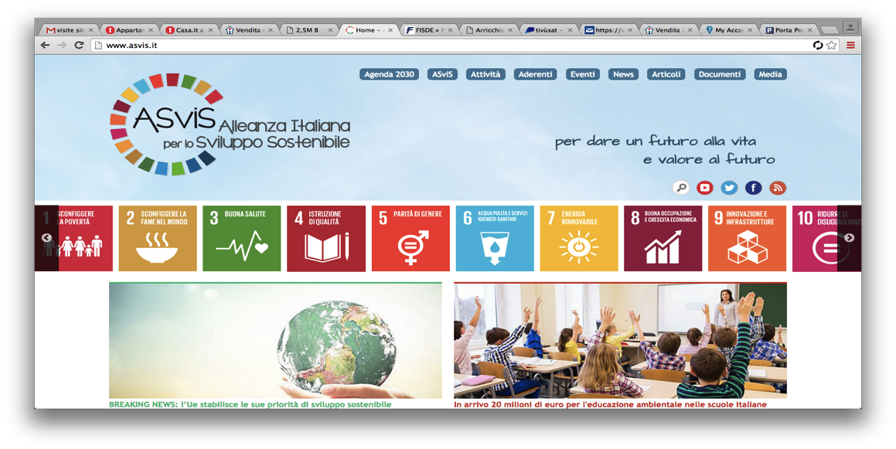
ASviS
The Alliance in numbers:
Unique case in Europe: over 200 members, with over 2,000 organizations, companies, NGOs, etc.
20 working groups, with 300 experts involved
Funded through contributions from members
ASviS indicators’ working group has been working on monitoring the Agenda 2030 since 2016 publishing trends of composite indicators for the 17 goals at Italian ad European level. We collaborate with several stakeholders on how to monitor progress toward the Agenda 2030 at different levels.

Slide 3
TUDCN
The Trade Union Development Cooperation Network (TUDCN) is an initiative of the International Trade Union Confederation (ITUC) that brings together:
  National trade union organisations affiliated to the ITUC,
  ITUC regional organisations
  Global Union Federations (GUFs),
  European Trade Union Confederation (ETUC) and
  Trade Union Advisory Committee to the OECD (TUAC)
  Solidarity Support Organisations (SSOs).
Objective: bringing the trade union perspective into international development policy debates and improve the coordination and effectiveness of trade union development cooperation activities.

Slide 4
Goal of the Research Partnership
Trade Unions contributed since the very beginning to the conception and the adoption of the Agenda 2030. The SDGs relevance to the trade union agenda connects to the inherent policy change that Agenda 2030 supports, such as:
  Going beyond the GDP rhetoric and affirming the need to address inequalities
  Calling enterprises to play a role in contributing to sustainable development
  Realize efficient public governance (national, regional, local governance)
In this context, SDG8 – Decent work and Economic growth - is perfectly coherent with and central to the trade union agenda.
Goal: ITUC partnered with the experts of ASviS to carry out a research project aimed at demonstrating the centrality of SDG8 within the 2030 Agenda.

Slide 5
The central role of SDG8
Integrating several topics among those related to growth, employment, productivity, working conditions and labor rights, SDG8 is per se a multidimensional goal playing a pivotal role within the 2030 Agenda.
It is essential for the Agenda 2030 that economic growth and full employment are pursued without jeopardizing the achievement of other targets such as those related to environmental and climate issues.
Given its centrality, reaching SDG8 targets will be functional to guarantee a full and holistic accomplishment of the 2030 ambitions.
Aim of the project: identifying the interactions among SDG8 targets and those related to other SDGs to verify the centrality of SDG8 within the general framework of the 2030 Agenda.

Slide 6
Main output of the project
Multi‐country Dataset on SDG8
Composite SDG8 index
  Geographical coverage: 166 countries equal to 98,9% of world population
  Methodologies adopted: Adaptation of AMPI (Mazziotta and Pareto, 2016)
Analysis of interactions between SDG8 and selected indicators of other goals
  Methodologies adopted: Factor Analysis
Position Paper
Notes:
Also trade union indicators, therefore additional to official indicators agreed by the United Nations. These are meant to complement the official indicators, covering issues of particular relevance to trade unions which have not been incorporated in the official process.

Slide 7
1. Multi‐country Dataset on SDG8
The first step of the analysis and a main substantive goal of the project is to build up a comprehensive dataset on SDG8 indicators covering the largest available number of countries.
The dataset encompasses both indicators identified by the United Nations in the 2030 Agenda and several relevant indicators considered key by TUDCN to measure the achievement of SDG8.
The dataset collects several indicators related to other SDGs in order to identify the main relevant interactions.

Slide 8
1. Multi‐country Dataset: Sources
All indicators were collected from official international sources such as:
  World Bank
  ILOSTAT
  LFS - Annual Labor Force Survey; HIES - Household budget Survey; HS - Continuous Household Survey; PC - Survey Population Census; Financial Access Survey (FAS)
  United Nations, Department of Economic and Social Affairs, Statistics Division (AMA)
  UN Environment Live / International Resource Panel Global Material Flows Database
  United Nations’ Development Programme Human Development Data
  UNICEF
  IMF's Statistics Department
  Penn State University (which includes data from ITUC Rights Index data from the Center for Global Workers’ Rights)

Slide 9
2. Composite SDG8 index: Rationale
A composite indicators of SDG8 is built with the following aims:
Measure the differences among countries with a single number
Give stakeholders, the media and the general public a synthetic, clear and easy to read measure of countries’ performance with respect to SDG8
Well aware that, in order to achieve the objectives of the 2030 Agenda, we all have to face the challenge of complexity, the composite index does not constitute a simplification of the problem, but rather a tool that allows for quick and concise monitoring.

Slide 10
2. Composite SDG8 index: Methodology
In this work we apply an adaptation of the AMPI methodology (Mazziotta and Pareto, 2016) that ASviS uses regularly to monitor the 2030 Agenda at Italian and European level.
The AMPI is a non-compensatory composite index based on a min-max normalization that transforms the metric of elementary indicators into a common scale index with mean=100 and standard deviation=10.
In order to perform absolute comparisons over time, AMPI proposes a re-scaling of the data in the range (70; 130) according to a goalpost that, in this case, is set as the world average of each elementary indicator.

Slide 11
2. Composite SDG8 Index: Selected Indicators
The selection of elementary indicators to be included in the composite index is the result of a delicate balancing between the indicators considered relevant from a theoretical point of view and the actual availability of data.
Name |  | Source | Unit | # Countries
Annual growth rate of real GDP per capita | World Bank |  | % | 207
Annual growth rate of output per worker | ILO Estimates |  | % | 179
Vulnerable employment (modeled ILO estimate)¹ | World Bank |  | % of total employment | 187
Domestic material consumption of fossil fuel per capita | Environment Live |  | tonnes | 169
Unemployment rate (modeled ILO estimate) | World Bank |  | % of total labor force | 187
Time-related underemployment rate | ILOSTAT |  | % | 170
Share of youth not in education, employment or training | ILOSTAT |  | % of youth population | 179
Level of national compliance of labor rights | ILO, PENN STATE UNIVERSITY |  | 0-10 index base | 187
Proportion of people 15 years and over with an account at a financial institution or mobile-money-service provider | World Bank |  | % of people aged 15 years and over | 169
Domestic credit provided by financial sector | World Development Indicators |  | % of GDP | 184
Labor income share as a percent of GDP | ILOSTAT |  | % | 110
Coverage: 166 countries equal to 98,9% of world population

Slide 12
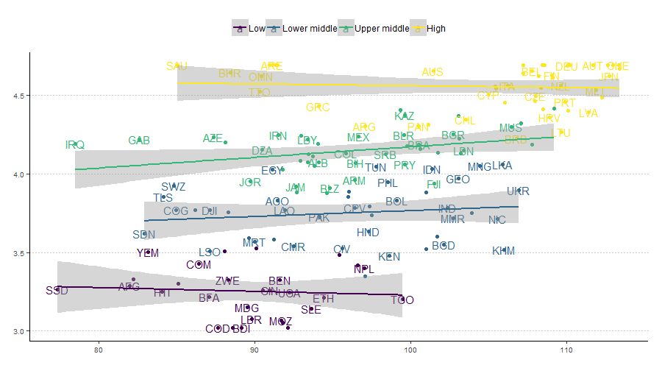
Composite x gni per capita

Slide 13

2. Composite SDG8 Index: Excluded Indicators
Constrained by a lack of available data and given the need to minimize the imputation of missing data to guarantee an objective and accurate analysis, the following indicators contained in the dataset are NOT included in the composite SDG8 index.
Indicator | Source | # Countries
Proportion of informal employment in non-agricultural employment | ILOSTAT | 69
Share of low paid work | ILOSTAT | 48
Gender wage gap | ILOSTAT | 32
Proportion and number of children aged 5-17 years engaged in child labor | UNICEF | 174
Frequency rates of fatal occupational injuries | ILOSTAT | 62
Frequency rates of non fatal occupational injuries | ILOSTAT | 64
Number of trained labor inspectors | ILOSTAT | 60
Collective bargaining coverage rate | ILOSTAT | 68
Trade union density rate | ILOSTAT | 77
It is extremely important to improve data collection and data monitoring to avoid the trade-off between accuracy of analysis and comprehensiveness of all dimensions. This appears to be particularly true for the dimension linked to labor rights and working conditions.

Slide 14
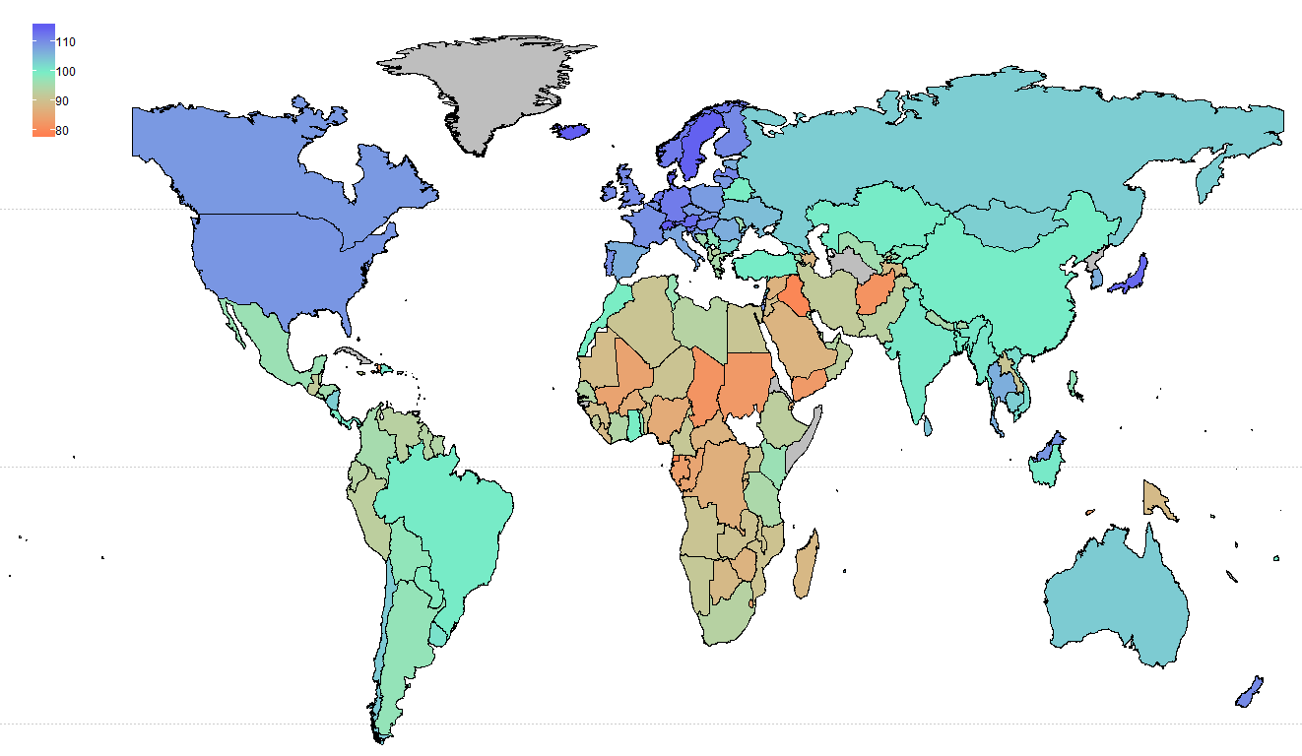
2. Composite SDG8 Index: Results

Slide 15
2. Composite SDG8 Index: Results
The map shows in
Blue: the best performers with values of the SDG8 composite index above 110 (i.e. USA, Canada, Japan and most EU countries).
Green: countries with a value of the SDG8 composite similar to the world average.
Orange: the worst performers (mainly African sub-Saharan countries and Middle East countries).

Slide 16
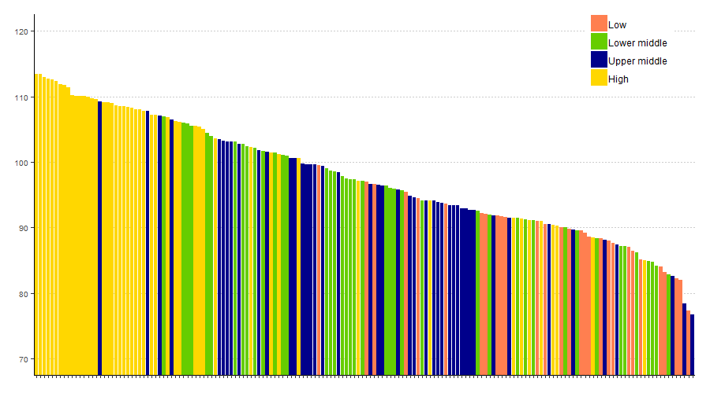
2. Composite SDG8 Index: Results

Slide 17
2. Composite SDG8 Index: Results
The figure above reports the ranking of the composite index for all countries grouped by the World Bank’s income group.
It is possible to notice that:
Best performers (with values of the SDG8 composite index above 110) are generally high-income countries. Out of the top 50 positions in the ranking, 38 are occupied by high-income countries.
Upper-income and low-income countries are quite widespread in the ranking.
Low-income countries, with some relevant and positive exceptions, are at the tail end of the ranking, showing a lower performance in the SDG8 composite index.

Slide 18
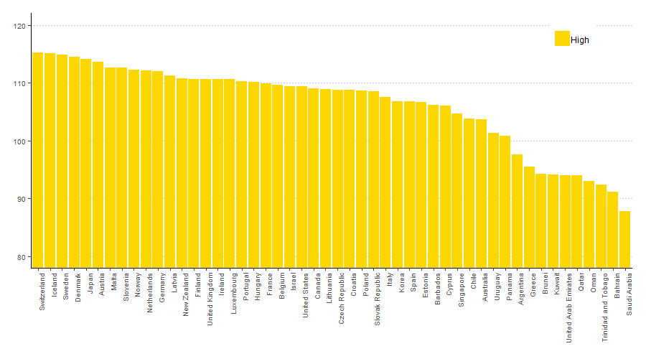
2. Composite SDG8 Index: Results

Slide 19
2. Composite SDG8 Index: Results
About high income countries:
19 high-income countries out of 50 report values of the SDG8 composite index above 110 and about 80% of high-income countries included in the analysis result with a composite score higher than the world average (100).
Evidence shows that most high-income countries perform generally better than the remaining countries although with some exceptions: UAE, Qatar, Oman, Trinidad and Tobago, Bahrain and Saudi Arabia. For these countries, the composite score ranges approximately between 94.07 and 87.82.
Looking at Europe, the EU Member States report an average value of the SDG8 composite index equals to 109.35 and among Member States only Greece shows a score below 100 (95.48).

Slide 20
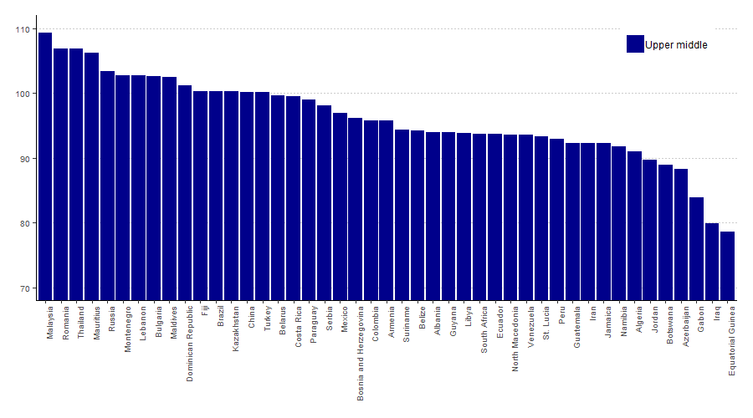
2. Composite SDG8 Index: Results

Slide 21
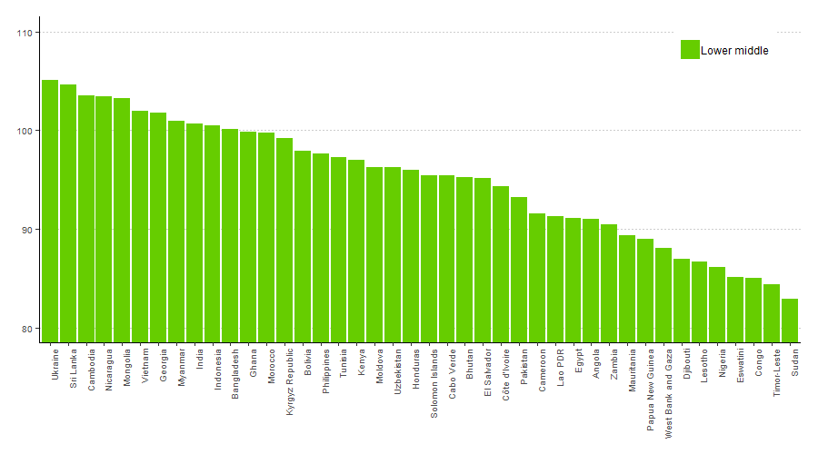
2. Composite SDG8 Index: Results

Slide 22
2. Composite SDG8 Index: Results
About Upper-middle income and Low-middle income countries:
Upper-middle income and lower-middle income countries surprisingly present similar performances on the SDG8 composite both with 10 countries performing above world average. Lower-middle income countries although have more countries below one st. dev (10 vs 6).
Among the upper-middle income countries, Malaysia (109.34), Romania (106.88), Thailand (106.83), Mauritius (106.19) and Russia (103.45) are the first 5 countries in the ranking. Ukraine (105.09), Sri Lanka (104.67), Cambodia (103.50), Nicaragua (103.44) and Mongolia (103.30) are the best performers of the low-middle income group.

Slide 23
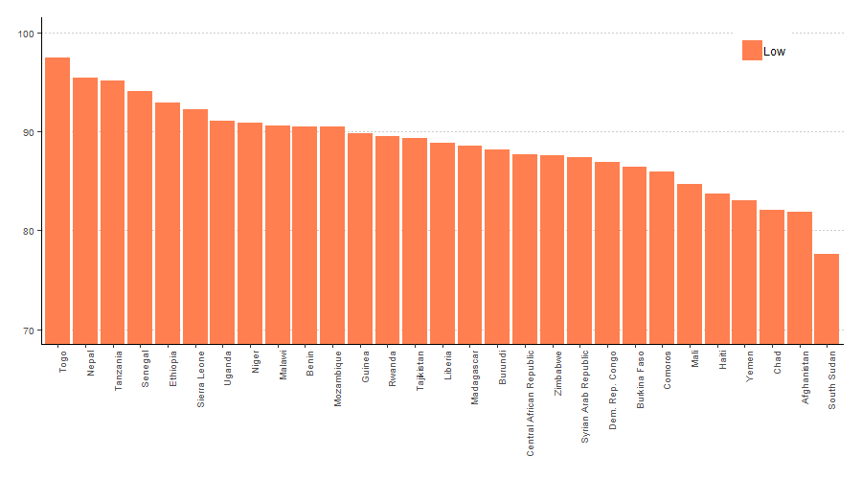
2. Composite SDG8 Index: Results

Slide 24
2. Composite SDG8 Index: Results
About low income countries:
In general, low-income countries show lower values of the index, ranging between 97.52 and 77.63. All low-income countries perform below the world average.
About 62% of low-income countries (18 countries out of 29) are below one standard deviation from the world average.
There are however some relevant exceptions such as Togo, Nepal and Tanzania, which have values close to the world average (respectively: 97.52, 95.48, 95.11).

Slide 25
Focus on Labor rights
High income countries
Upper middle income countries

Slide 26
Focus on Labor rights
Lower middle income countries
Low income countries

Slide 27

Focus on Labor rights
the values of the SDG8 composite index (lhs)
The figures above relate
with
the indicator “Level of national compliance of labor rights”
The indicator “Level of national compliance of labor rights”, whose source is Penn State University, includes data from the ITUC Rights Index that draw data from the Center for Global Workers’ Rights.
The indicator, somehow complementary to the one above is key in our analysis as it is the only usable indicator referring to Target 8.8 “Protect labor rights and promote safe and secure working environments for all workers, including migrant workers, in particular women migrants, and those in precarious employment”.

Slide 28
Focus on Labor rights
Taking the entire sample as a reference:
  The negative correlation is significant (also because of multicollinearity), so we measured the relationship the correlation within the same income group.
Observing within income groups:
  A significant negative correlation exists for high-income, upper-middle income and low-income countries, while no significant correlation seems to exist within the group of lower-middle income countries.
  The low values of the SDG8 composite for the United Arab Emirates, Saudi Arabia and Qatar can be attributed almost entirely to a weak performance with respect to this indicator and in general to an underperformance linked to the dimension of labor rights and working conditions. In several cases - such as Turkey, the Philippines, Malaysia and Thailand - despite the relatively good performance of the indicator, the labor right index reports weak performances. Conversely, Togo and Nepal’s good performances in the labor right indicator are reflected in a high value of the composite index.

Slide 29













3. SDG8 – Linkages with other goals
Insert
Commento
Weak linkages (1-3)
Medium linkages (4-10)
Strong linkages (>10)
Notes:
Not linked 7 (energy), 13 climate action, 14 life below water, 15 life on land

Slide 30
4. SDG8 - Position paper
Main objectives
Underlining gaps at country/region level with respect to SDG8 targets
Analyzing main links and tradeoff among SDG8 and other SDGs in terms of policy implications
Highlighting how TU’s priorities (i.e. Labor Rights Implementation, Occupational Health and Safety respected, Expansive policies on Wages) can contribute to the achievement of the 2030 ambitions
Addressing the problem of «policy coherence and integration» with a particular focus on SDG8

Slide 31
Conclusions
Providing both a dashboard of SDG8 indicators (the dataset) and the single composite indicator, the work gives both multifaceted and simplified holistic information on the development of SDG8.
Analyzing interactions among indicators, the project showcases the centrality of SDG8. Key findings on the correlations have relevant and significant policymaking implications. completare in seguito all’analisi delle interazioni
A main goal of the analysis is to demonstrate that by leveraging on the achievement of SDG8 targets, policymakers can indeed make an impact on non-SDG8 targets with positive externalities to several dimensions of sustainable development and ultimately to the wellbeing of citizens.
The focus on labor rights as well as working conditions shows that some countries - despite having good results on economic growth and productivity - need to improve on labor markets policies, social protection systems, occupational safety and compliance with labor rights.

Slide 32
Thank you for the attention

